Slide 1
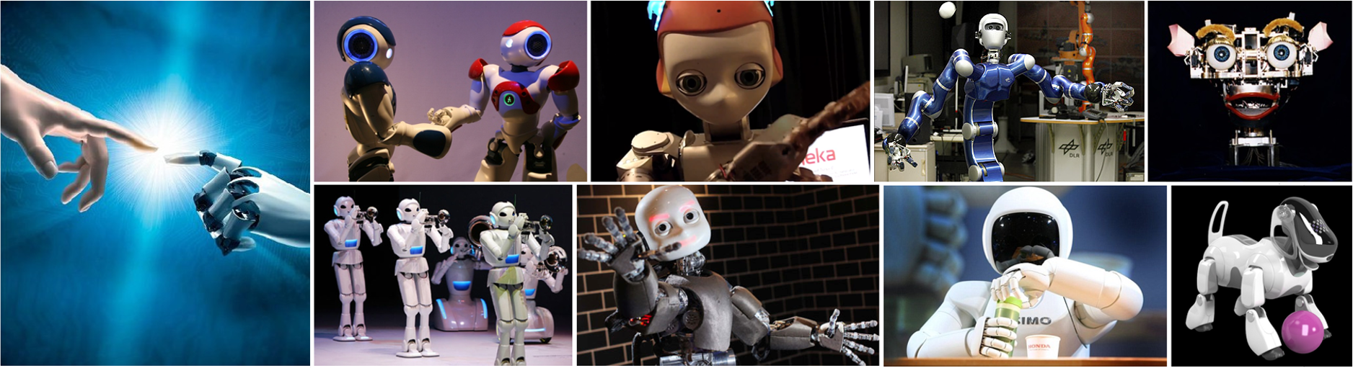
CMSC 591
Robotic Vision
Notes:
1

Slide 2
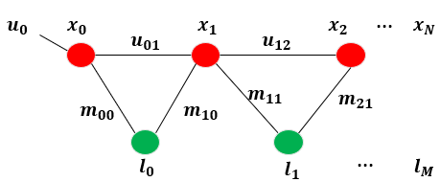
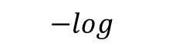
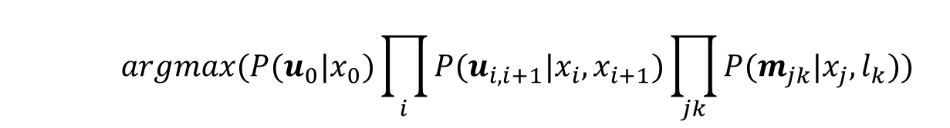
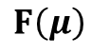
Graph SLAM
MAP (maximum a posterior probability)
$$\max{P\left(x_{0},x_{1},…x_{N−1},x_{N},l_{0},l_{1}…l_{M}\right|u_{01}u_{12}…u_{N−1N}m_{00}m_{11}…m_{N1})}$$
Nodes
Edges
$$argmax(P(u_{0}|x_{0})\prod_{i}{P(u_{i,i+1}|x_{i},x_{i+1})}\prod_{jk}{P(m_{jk}|x_{j},l_{k})})$$
Prior Constraint
Odometry Constraint
Landmark Constraint
$$−log$$
$argmin\left(\sum_{k=1}^{K}{e_{k}^{T}Σ^{−1}e_{k}^{}}\right)=argmin\left(\sum_{k=1}^{K}{{\left(z_{k}^{}\text{−}\hat{z_{k}}\left(μ\right)\right)}_{}^{T}Ω_{k}\left(z_{k}^{}\text{−}\hat{z_{k}}\left(μ\right)\right)}\right)$= $argmin\left({\left(z\text{−}\hat{z}\left(μ\right)\right)}_{}^{T}Ω\left(z\text{−}\hat{z}\left(μ\right)\right)\right)$
LSP (Least Squares Problem) $μ^{∗}=argmin$($F$($μ$))
$$F\left(μ\right)$$

Slide 3

Nonlinear Least Square Optimization
solve $μ^{∗}=argmin$($F$($μ$)) by iterative relinearization

Slide 4
Outline
Nonlinear Least Square Optimization
Gradient Descent
Gauss Newton (GN) and Levenberg-Marquardt (LM)
G2O and GTSAM
Applications
Programming
C++ example
GTSAM in Matlab

Slide 5
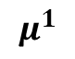
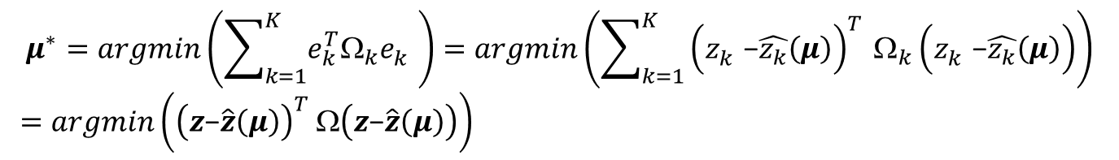
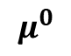
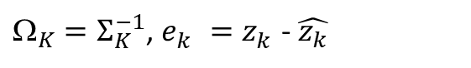
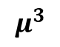
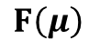
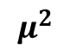
Nonlinear Least Square Optimization
$_{K}=Σ_{K}^{−1}$, $e_{k}^{}=z_{k}^{}$- $\hat{z_{k}}$
$$μ^{∗}=argmin\left(\sum_{k=1}^{K}{e_{k}^{T}Ω_{k}e_{k}^{}}\right)=argmin\left(\sum_{k=1}^{K}{{\left(z_{k}^{}\text{−}\hat{z_{k}}\left(μ\right)\right)}_{}^{T}Ω_{k}\left(z_{k}^{}\text{−}\hat{z_{k}}\left(μ\right)\right)}\right)$$
$=argmin\left({\left(z\text{−}\hat{z}\left(μ\right)\right)}_{}^{T}Ω\left(z\text{−}\hat{z}\left(μ\right)\right)\right)$
Predicted Measurement
True
Measurement
$$F\left(μ\right)$$
Gradient Descendent
gradient
Parameter update
$F\left(μ\right)=−2{\left(z\text{−}\hat{z}\left(μ\right)\right)}_{}^{T}Ω\left[\frac{∂\hat{z}\left(μ\right)}{∂μ}\right]=−2 {\left(z\text{−}\hat{z}\left(μ\right)\right)}_{}^{T}Ω J$
$$μ^{0}$$
$$μ^{1}$$
$$μ^{k+1}=μ^{k}−α{(∇F\left(μ\right))}^{T}$$
$$μ^{2}$$
Learning rate
$$μ^{3}$$
Notes:
mapping (SLAM) or bundle adjustment (BA) can be phrased as least squares optimization of an error function that can be represented by a graph.

Slide 6
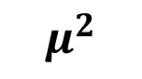
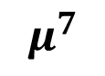
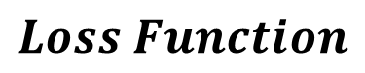
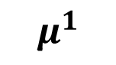
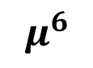
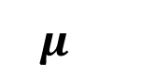
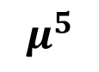
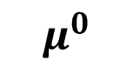
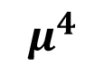
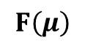
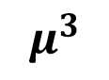
Gradient Descendent
$$μ^{k+1}=μ^{k}−α{(∇F\left(μ\right))}^{T}$$
Learning rate
$$Loss Function$$
$$F\left(μ\right)$$
$$μ^{}$$
$$μ^{0}$$
$$μ^{1}$$
$$μ^{2}$$
$$μ^{3}$$
$$μ^{6}$$
$$μ^{5}$$
$$μ^{4}$$
$$μ^{7}$$

Slide 7
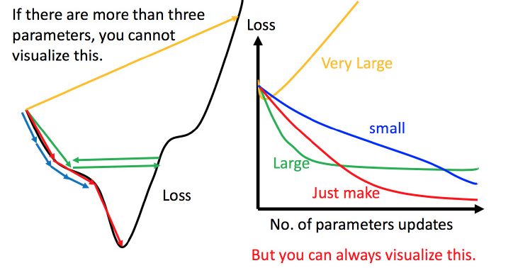
Learning rate
$$μ^{k+1}=μ^{k}−α{(∇F\left(μ\right))}^{T}$$
Learning rate
Gradient Descendent cannot find a proper solution if learning rate is too large,
or converges so slow if learning rate is too small

Slide 8
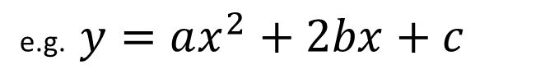
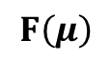
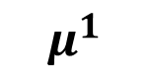
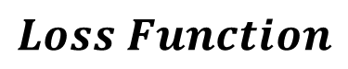

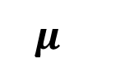
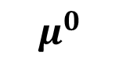
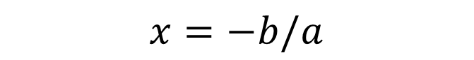
Gauss Newton
Locally quadratic polynomial
e.g. $y=ax^{2}+2bx+c$
$$x=−b/a$$
$$Loss Function$$
$$F\left(μ\right)$$
$$μ^{}$$
$$μ^{0}$$
$$μ^{1}$$
$$μ^{1}$$

Slide 9
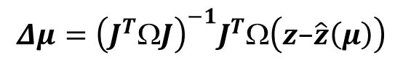
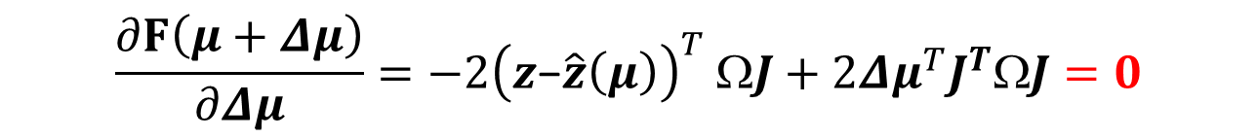
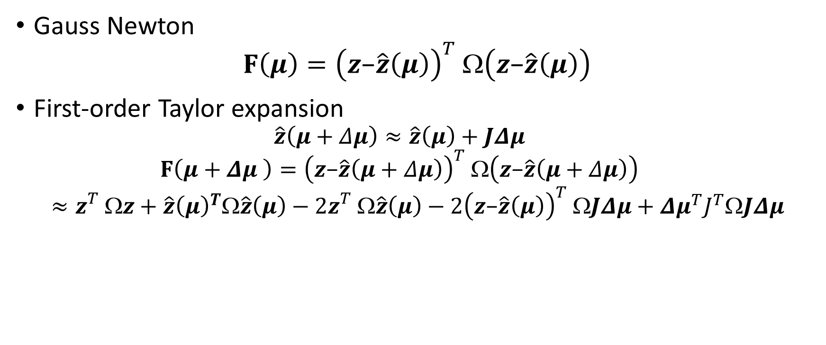
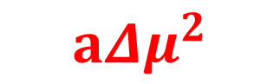
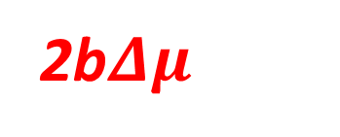
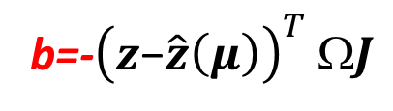
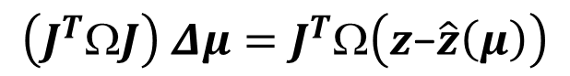
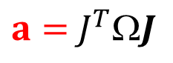
Nonlinear Least Square Optimization
Gauss Newton
$$F\left(μ\right)={\left(z\text{−}\hat{z}\left(μ\right)\right)}_{}^{T}Ω\left(z\text{−}\hat{z}\left(μ\right)\right)$$
First-order Taylor expansion
$$\hat{z}\left(μ+Δμ\right)≈\hat{z}\left(μ\right)+JΔμ$$
$$F\left(μ+Δμ \right)={\left(z\text{−}\hat{z}\left(μ+Δμ\right)\right)}_{}^{T}Ω\left(z\text{−}\hat{z}\left(μ+Δμ\right)\right)$$
$$≈z_{}^{T}z+{\hat{z}\left(μ\right)}^{T}\hat{z}\left(μ\right)−2z_{}^{T}\hat{z}\left(μ\right)−2{\left(z\text{−}\hat{z}\left(μ\right)\right)}_{}^{T}JΔμ+{Δμ}^{T}J^{T}JΔμ$$
$$x=−b/a$$
c
2b$Δμ$
$$a{Δμ}^{2}$$
$$\frac{∂F\left(μ+Δμ\right)}{∂Δμ}=−2{\left(z\text{−}\hat{z}\left(μ\right)\right)}_{}^{T}ΩJ+2{Δμ}^{T}J^{T}ΩJ=0$$
$$\left(J^{T}ΩJ\right) Δμ=J^{T}Ω\left(z\text{−}\hat{z}\left(μ\right)\right)$$
$$Δμ={\left(J^{T}ΩJ\right)}^{−1}J^{T}Ω\left(z\text{−}\hat{z}\left(μ\right)\right)$$
$a=$ $J^{T}J$
b=-${\left(z\text{−}\hat{z}\left(μ\right)\right)}_{}^{T}ΩJ$

Slide 10
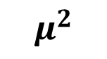
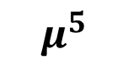
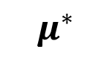
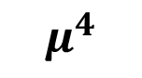
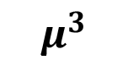
Gauss Newton
$$x=−b/a$$
$$Loss Function$$
$$F\left(μ\right)$$
…
$$μ^{}$$
$$μ^{0}$$
$$μ^{5}$$
$$μ^{∗}$$
$$μ^{1}$$
$$μ^{2}$$
$$μ^{3}$$
$$μ^{4}$$

Slide 11
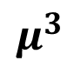
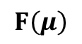
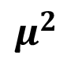
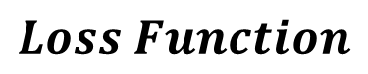
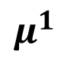
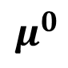



Gauss Newton
$$Loss Function$$
$$F\left(μ\right)$$
Too slow if the initial value $μ^{0}$ is far from the optimal $μ^{∗}$
。。。
$$μ^{0}$$
$$μ^{1}$$
$$μ^{2}$$
$$μ^{3}$$
$$μ^{∗}$$
$$μ^{}$$

Slide 12



















Levenberg Marquardt
$$\left(J^{T}ΩJ\right) Δμ=J^{T}Ω\left(z\text{−}\hat{z}\left(μ\right)\right)$$
damping parameter $λ$
$$Loss Function$$
$$\left(J^{T}ΩJ+λI\right) Δμ=J^{T}Ω\left(z\text{−}\hat{z}\left(μ\right)\right)$$
$$F\left(μ\right)$$
$$λ$$
$$Δμ$$
$$λ$$
$$Δμ$$
If ${F\left(μ\right)}^{k+1}<{F\left(μ\right)}^{k}$, decrease $λ$
If ${F\left(μ\right)}^{k+1}>{F\left(μ\right)}^{k}$, increase $λ$, redo k th iteration
$$λ$$
$$λ$$
$$λ$$
$$λ$$
$$μ^{0}$$
$$μ^{1}$$
$$μ^{2}$$
$$μ^{3}$$
$$μ^{4}$$
$$μ^{4}$$

Slide 13












Summary
$$μ^{0}$$
$$μ^{∗}=argmin\left({\left(z\text{−}\hat{z}\left(μ\right)\right)}_{}^{T}Ω\left(z\text{−}\hat{z}\left(μ\right)\right)\right)$$
$$μ^{1}$$
Machine Learning
$$μ^{2}$$
$$F\left(μ\right)$$
Gradient Descendent (GD)
Steepest direction
Gauss Newton (GN)
Locally quadratic fitting
Levenberg Marquardt (LM)
Damping parameter
$$μ^{k+1}=μ^{k}−α{(∇F\left(μ\right))}^{T}$$
$$μ^{3}$$
$$Δμ={\left(J^{T}ΩJ\right)}^{−1}J^{T}Ω\left(z\text{−}\hat{z}\left(μ\right)\right)$$
$μ^{k+1}=μ^{k}$+ $Δμ$
$$Δμ={\left(J^{T}ΩJ+λI\right)}^{−1}J^{T}Ω\left(z\text{−}\hat{z}\left(μ\right)\right)$$
$$x=−b/a$$
$μ^{k+1}=μ^{k}$+ $Δμ$
Robotics Community

Slide 14

Why machine learning/ deep learning does not use GN/LM?
GN/LM cost more computational time than GD
Efficiency: too much computational burden if use GN/LM, since too many parameters ~${10}^{7}$

Slide 15


What if number of nodes in SLAM grows to ${10}^{7}$, efficiency issue?
Wang, Rui, Martin Schworer, and Daniel Cremers. "Stereo DSO: Large-scale direct sparse visual odometry with stereo cameras." Proceedings of the IEEE International Conference on Computer Vision. 2017.

Slide 16









What if number of nodes in SLAM grows to ${10}^{7}$, efficiency issue?
No
Update Check
Submapping (Divide and Conquer)
…
$$1$$
$$2$$
$$3$$
$${10}^{7}$$
Sliding window
…
…
…
$$1$$
$$2$$
$$3$$
$${10}^{7}$$

Slide 17
























G2O
Kümmerle, Rainer, et al. "g2o: A general framework for graph optimization." IEEE International Conference on Robotics and Automation., 2011
$$\max{P\left(x_{0},x_{1},…x_{N−1},x_{N},l_{0},l_{1}…l_{M}\right|u_{01}u_{12}…u_{N−1N}m_{00}m_{11}…m_{N1})}$$
Gauss Newton (GN)
Locally quadratic fitting
Levenberg Marquardt (LM)
Damping parameter
$$x_{0}$$
$$x_{1}$$
$$x_{2}$$
$$u_{0}$$
$$x_{0}$$
$$x_{1}$$
$$x_{2}$$
$$e_{01}$$
$$e_{12}$$
$$u_{01}$$
$$u_{12}$$
$$m_{11}$$
$$e_{14}$$
$$e_{24}$$
$$m_{21}$$
$$e_{03}$$
$$e_{13}$$
$$m_{00}$$
$$m_{10}$$
$$l_{0}$$
$$l_{1}$$
$$x_{3}$$
$$x_{4}$$

Slide 18






Graph Model in G2O
$$x_{0}$$
$$x_{1}$$
$$x_{2}$$
$$e_{01}$$
$$e_{12}$$
$$e_{14}$$
$$e_{24}$$
$$e_{03}$$
$$e_{13}$$
$$x_{3}$$
$$x_{4}$$
$$e_{ij}\left(x\right)=z_{ij}−{\hat{z}}_{ij}$$
Kümmerle, Rainer, et al. "g2o: A general framework for graph optimization." IEEE International Conference on Robotics and Automation., 2011
Notes:
In G2O, all the variables are generally treated as nodes, representing the parameters to be estimated. They are denoted as x. An edge is represented by the residual error of its constraint, which is denoted by e. Each constraint is modeled like this figure. The zij and Omega represent the mean and information matrix of a constraint relating to the parameters xi and xj. Z hat ij, represents the estimator for the mean value of this measurement constraint. This constraint could be a odometry measurement, or a landmark measurement.
The difference between the estimator z hat ij and the true mean value is called the residual error.

Slide 19



















G2O
$$x_{0}$$
$$x_{1}$$
$$x_{2}$$
$$e_{01}$$
$$e_{12}$$
Taylor expansion
$$e_{14}$$
$$e_{24}$$
$$e_{03}$$
$$e_{13}$$
$$x_{3}$$
$$x_{4}$$
Quadratic polynomial
$$∆x=−b/a$$
Sum up

Slide 20




G2O
$$x_{0}$$
$$x_{1}$$
$$x_{2}$$
$$e_{01}$$
$$e_{12}$$
$$e_{14}$$
$$e_{24}$$
$$e_{03}$$
$$e_{13}$$
$$x_{3}$$
$$x_{4}$$
$$x=−b/a$$
Iteration
or
Kümmerle, Rainer, et al. "g2o: A general framework for graph optimization." IEEE International Conference on Robotics and Automation., 2011

Slide 21

G2O Framework
Kümmerle, Rainer, et al. "g2o: A general framework for graph optimization." IEEE International Conference on Robotics and Automation., 2011
Notes:
This is a overview about the G2O framework. From the beginning, the error function of the edge constraints need to be defined. Also, the nonlinear add operator needs to be defined. Next, the jacobian, In G2O, in default, it provides numeric jacobian, so its optional to write your own jacobian. If you do that, it will reduce computation cost and increase speed. In g2o, it use Levenberg Marquardt algorithm. The linear solver and the linear structure are provided. You can choose one of them.
So, to address a new optimization problem, only the boxes in blue rectangle need to specified. If your parameters are in the Euclidean space, you even do not need to specify the nonlinear add operator.
The jacobian is optional. For the others, you can choose by setting certain parameters, which I will show you later. So, you can notice that G2O is very easy to use. You need to understand your problem and defines the error functions of your variables in different constraints.

Slide 22
https://github.com/RainerKuemmerle/g2o

Slide 23











GTSAM
variable nodes
($x_{0},x_{1},…,x_{N}$, $l_{0},l_{1}…l_{M}$)
factor nodes
$$P\left(u_{0}\right|x_{0}x_{1})$$
$$P\left(m_{0}\right|x_{0}l_{0})$$
…
Odometry measurement
$$p$$
$$x_{0}$$
$$x_{1}$$
$$x_{2}$$
$$u_{0}$$
$$u_{1}$$
$$m_{0}$$
$$m_{2}$$
$$m_{3}$$
$$m_{1}$$
Landmark measurement
$$l_{0}$$
$$l_{1}$$
$$\operatorname{argmax}{P\left(x_{0},x_{1},…x_{N−1},x_{N},l_{0},l_{1}…l_{M}\right|u_{01}u_{12}…u_{N−1N}m_{00}m_{11}…m_{N1})}$$

Slide 24












Nonlinear Least-Squares
$$c_{0}$$
$$p$$
$$x_{0}$$
$$u_{0}$$
$$x_{1}$$
$$u_{1}$$
$$x_{2}$$
$$m_{2}$$
$$m_{3}$$
$$m_{0}$$
$$m_{1}$$
$$x_{3}$$
$$x_{4}$$
Taylor Expansion
Cholesky
QR
Notes:
The graph itself is factorization of a probability distribution. So factor graph factorize the probability density where each of this terms correspond to one of the factors one of constraint.
By assuming gaussian noise, this maximize likelihood problem can be converted to a least square problem. Minimize the sum of the squared cost functions. This is typically be done in a gauss newton or Levenberg Marquardt framework by iteratively solving the linearized version of the systems. Each time update the estimate until converging, so this linear system contains matrix A, that so called measurement jacobian, these are linearized measurements, so each row contains a measurement of the columns of the variables. The top hill are the odometry measurement, diagonal. The bottom contains the landmark measurements, so each row contains one pose and one landmark.
The right is the vector b, that is the residuals of the system.
How to solve this problem efficiently?

Slide 25




Different from G2O
Taylor expansion
$_{ij}=_{ij}^{1/2}_{ij}^{T/2}$,
define $A_{ij}=_{ij}^{T/2}J_{ij}$,and $b_{ij}=_{ij}^{T/2}e_{ij}$
$$F_{ij}={\left(A_{ij}∆x+b_{ij}\right)}^{T}\left(A_{ij}∆x+b_{ij}\right)={\left\|A_{ij}∆x+b_{ij}\right\|}^{2}$$
or
$$F_{}={\left\|A∆x+b\right\|}^{2}$$
$${∆x}^{∗}=argmin({\left\|A∆x+b\right\|}^{2})$$
G2O
GTSAM

Slide 26



Solving the Linear Least Squares System
QR decomposition
$${∆x}^{∗}=argmin({\left\|A∆x+b\right\|}^{2})$$
A = QR
Givens
rotations
Measurement Jacobian
Notes:
Another solution to this linear Least squares problem is based on QR decomposition. You can decompose the measurement jacobian matrix A by a orthogonal matrix Q times a upper triangle matrix R. As denoted in this equation. Then the LSQ problem can be written in this form by using Q and R to represent A. Then times Q transpose to this equation, since Q is orthogonal matrix, times Q does not change the norm value.
QtQ equals to identity matrix, Qtb can be written as [d c]. By removing the bottom part, ends up with these two parts. The second item c square is const, so, the solution is to minimize the first item. And it can be simply computed by solving R dx = -d.
Again if R is sparse, then it can be solved very efficiently.

Slide 27





Retaining Sparsity: Variable Ordering
QR
Default Ordering
COLAMD permute
QR
Ordering based on
COLAMD heuristic
Notes:
Unfortunately, if you directly do QR decomposition to the original matrix A, it end up with a dese matrix R,
As well known in linear algebra,
You can permute the rows and columns of the original matrix, and end up with an equivalent matrix denotes the same system. But when you factorize this one, you will end up with a sparse squared root matrix
Question is, how do you find such an ordering？
According to COLAMD heuristic, an approximate best ordering can be retrieved. This strategy has been used in matlab, so if in matlab you type A\b and A is a sparse matrix, it will exactly does the same as we have discussed here.
Similarly, direct run QR decomposition will end up with a dense and usually large size matrix. Instead, applying the reordering algorithm based on COLAMD heuristic, we can get a permuted matrix A’ that represents the same system with A. Then running the QR decomposition again we will end up a sparse matrix R’. With this sparse one, the solution can be solved very efficiently.

Slide 28






G2O and GTSAM
$${∆x}^{∗}=argmin({\left\|A∆x+b\right\|}^{2})$$
GTSAM
G2O
Notes:
The cost for both methods is similar, for Cholesky is lighter but demands the construction of H = A>A. The following graph illustrates the paths for both methods, starting at the time where a factor wants to be incorporated to the problem.

Slide 29



iSAM [Kaess et al., TRO 08]
Growing system
Batch solution becomes expensive
Incremental system
Given R from previous step, how to add new measurements ?
Key idea:
Append to existing matrix R
Using Givens rotations
Notes:
But SLAM problem involves a growing system, as the robot traverses round the environment, more robot poses and landmark observations result in a large-scale jacobian matrix. To solve the linearized system, we have to repeatedly decompose this matrix, which will become more expensive as the system grows with time.
A better way is incremental

Slide 30


Slide 31


Visual-Inertial Odometry
IMU Integrate + Visual Odometry
https://www.youtube.com/watch?v=CsJkci5lfco&feature=youtu.be
Indelman, Vadim, et al. "Information fusion in navigation systems via factor graph based incremental smoothing." Robotics and Autonomous Systems 61.8 (2013): 721-738.

Slide 32

https://www.youtube.com/watch?v=BgLlLlsKWzI&feature=youtu.be

Slide 33

https://www.youtube.com/watch?v=m_bLSdsT2kg&feature=youtu.be

Slide 34

https://www.youtube.com/watch?v=2A7lOipPNBA&feature=youtu.be

Slide 35

https://www.youtube.com/watch?v=Zjevg5wQTdI&t=1409s

Slide 36

3D Dynamic Scene Graphs: Actionable Spatial Perception with Places, Objects, and Humans
https://www.youtube.com/watch?v=SWbofjhyPzI
Notes:
Semantic decomposition of the space at different levels.

Slide 37

https://github.com/jczarnowski/DeepFactors

Slide 38

https://arxiv.org/abs/1803.07531

Slide 39

https://www.youtube.com/watch?v=mVA8qhGf7So&feature=youtu.be

Slide 40

https://arxiv.org/pdf/1911.08002.pdf

Slide 41


Slide 42
https://gtsam.org/get_started/
https://github.com/borglab/gtsam
https://www.youtube.com/watch?v=QgpmMn9K5Eo
https://www.youtube.com/watch?v=Q313pTMAdcM&t=1340s
https://www.youtube.com/watch?v=_W3Ua1Yg2fk&t=695s

Slide 43





Slide 44

C++ Example

Slide 45

C++ Example

Slide 46

C++ Example

Slide 47
C++ Example
https://github.com/dongjing3309/gtsam-examples
https://github.com/rising-turtle/slam_course

Slide 48


Matlab Example
https://borg.cc.gatech.edu/download.html

Slide 49
Materials
Kümmerle, Rainer, et al. "g2o: A general framework for graph optimization." IEEE International Conference on Robotics and Automation., 2011.
g2o manual
Joan Sol`, “Course on SLAM”, 2016
Förstner, Wolfgang. "Minimal representations for uncertainty and estimation in projective spaces." Asian Conference on Computer Vision. Springer, Berlin, Heidelberg, 2010.
GTSAM 2006 & ISAM 2008 & ISAM2 2011
gtsam manual: Factor Graphs and GTSAM: A Hands-on Introduction
gtsam tutorial & icra16_slam_tutorial_kaess
Rosen, David M., Michael Kaess, and John J. Leonard. "Robust incremental online inference over sparse factor graphs: Beyond the Gaussian case." 2013 ICRA

Slide 50

Questions?
https://github.com/rising-turtle/slam_course

Slide 51


Algorithms
QR decomposition
Cholesky decomposition
GTSAM
G2O

Slide 52





Retaining Sparsity: Variable Ordering
factor
Default Ordering
Matrix factorization
$$A^{T}A=R^{T}R$$
first $R^{T}y=A^{T}b$
second $Rθ=y$
COLAMD permute
factor
Ordering based on
COLAMD heuristic
Notes:
Unfortunately, if you directly decompose AtA, it end up with a dese matrix R,
As well known in linear algebra,
You can permute the rows and columns of the original matrix, and end up with an equivalent matrix denotes the same system. But when you factorize this one, you will end up with a sparse squared root matrix
Question is, how do you find such an ordering？
According to COLAMD heuristic, an approximate best ordering can be retrieved. This strategy has been used in matlab, so if in matlab you type A\b and A is a sparse matrix, it will exactly does the same as we have discussed here.

Slide 53




Solving the Least Squares System
Normal Equation
$$A^{T}Aθ=A^{T}b$$
Cholesky decomposition
Symmetric Matrix
Matrix factorization
$$A^{T}A=R^{T}R$$
$R^{T}Rθ$= $A^{T}b$
first $R^{T}y=A^{T}b$
second $Rθ=y$
Square root Matrix
Measurement Jacobian
Notes:
To solve this squared function, the simple way is to take derivative, and set the derivative to zero. You get the normal equation, that is . The AtA squared of the jacoabians.
How to solve this normal equation.
One way is to invert the information m, bad, the inversion is a dense matrix, and this matrix is usually very large. Hundreds or thousands items. You have a dense matrix here, you cannot do any thing efficient.
Instead, isam take the sparsity of this matrix. For example, Cholesky factorization end up a upper triangular matrix R, that AtA = RtR. This is so called square root information matrix. You can simply do forward and backward substitution to recover this solution. If the matrix R is sparse, this can be done very efficiently.

Slide 54


Links between methods: Cholesky and QR
Hessian Matrix H
Measurement Jacobian A
Squared Root Matrix R
Notes:
It is interesting to see that the Cholesky method and the QR method are not that far apart. Indeed, if we consider a symmetric, positive-definite matrix H = A>A, with A rectangular, then the QR decomposition of A is. Whereas the Cholesky decomposition of H is, the two factorization share the same matrix R, as is shown in this equation.

